Slide 1





KU Enterprise Management Company
Khalifa University Establishing Science and Technology Companies
The Right Move…….
1

Slide 2
Part 1 Proposed Operating Model

Slide 3











Proposed Operating Model for Khalifa University Enterprises Management Company
Investment Committee of the Board of Trustees
KU Enterprises Management Company
1
KU Ventures
Innovation Acceleration & Startups
Annual contribution
Endowment Fund
~AED105 million
2
3
Long-term financial returns
Supports establishing and operating non-IP technology companies that can provide valuable technical products and services
Supports commercialization of university IP through funding innovation programs and investing in startups
Operational Allocation
~AED 25 million
Investment Allocation
AED 80 million
Jinomix
Ventures and Innovation Fund
~AED15 million
Wastewater
Manufacturing Reagents
Other Operational Fund
~AED10 million
Sports Equipment

Slide 4

1. KU Ventures support establishing zero/low risk technology based companies that offer technical products and services.
1. KU Ventures
Technology Companies
Operational Assets
Advisory Services
Jinomix
Wastewater
Transfer Ankabut stake from KU to the Enterprise Management Company
Operate Ankabut as a standalone commercial entity with its own Finance, HR, Marketing, & Procurement divisions, to unlock business opportunities (expanding beyond education sector and beyond UAE)
Provide advisory and consultancy services to the community, using high profile and experience of university faculties and staff in different scientific and technical areas of need and impact to UAE.
Manufacturing of RNA Extraction Reagents
Sports Equipment
Manufacturing Company

Slide 5








2. Innovation Acceleration supports commercialization of university IP through funding startups around KU research and IP
2. Innovation Acceleration & Startups
Journey from University Research to Company Launch
University Research
Intellectual Property
Start-Up Education
Start-Up Creation
Professors and students perform research in their areas of focus
Professors and students develop inventions and patents based on their research.
KU Metrics to date:
- 443 inventions
- 240 filed patents
- 189 issued patents
- 11 startups
KIC and Techstars can provide training for students and professors on how to build start-ups and raise venture capital financing
Techstars and Khalifa University collaborate to:
1. Identify the best IP
2. Identify business opportunities for that IP
3. Design a basic product
4. Market test the product
5. Build the start-up team
6. Prepare for fundraising

Slide 6
Financial Assets
3. Endowment Fund preserves capital and generates returns to support KU Enterprises and Innovation Fund Activities*
~AED80m of the principle Endowment Fund will be managed by an external manager. Based on initial discussions, ADIA recommended BlackRock to be the most suitable asset manager
~AED 25m of the principle Endowment Fund will be managed by a local investment entity (e.g. ADCB) and will be accessible to KU Enterprise Management Company
~AED15m (~15% of the principal endowment) to be allocated to support Venture and Innovation Acceleration funds under KU Enterprise Management Company.
~AED10m to be reserved as an Operational Fund that can be accessed on need basis.
100% of annual profits to support annual contributions of AED ~5m to the Innovation Fund to fund the IP commercialization activities
3. Endowment Fund
~AED105 million
Operational Allocation
~AED 25 million
Investment Allocation
AED 80 million
Ventures and Innovation Fund
~AED 15 million
Other Operational Fund
~AED 10 million
* Above listed recommendations are endorsed by the Investment Committee

Slide 7
Part 2 Proposed Governance Model

Slide 8
Proposed Governance Model Options for the proposed governance structure
Option 1
Option 2
Option 3
Board of Trustees
Investment Committee
Non-voting ex officio member
Board of Trustees
Investment Committee
Board of Trustees
Investment Committee
President of KU and CEO of Enterprises Company
KU VP Business Development & CEO of Enterprises Company
President
President
KU VP Business Development & CEO of Enterprises Company
KU Ventures
KU Endowment Fund
KU Ventures
KU Endowment Fund
Innovation Acceleration & Startups
Innovation Acceleration & Startups
KU Ventures
KU Endowment Fund
Innovation Acceleration & Startups

Slide 9
Part 3 Khalifa University Financial Sustainability

Slide 10
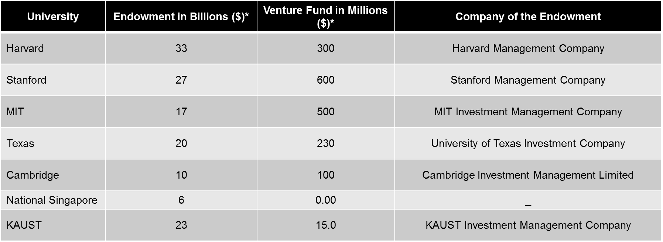
Perspectives on Management of Endowments in Top-Ranked Universities:
Benchmark
Top ranked universities utilize its endowments to effect its research and economic development agendas.
For example, universities uses revenue returns from investments in further funding its scientific research.
Similarly, invest in the outcomes of its research such as technologies, industry partnerships and startups to create economic impact.
Universities use portion of the endowment to invest to accelerate the economic impact (Venture Fund).
B
M
B
M
B
M
B
M
B
M
B
M
B
M
* Please note these numbers are the closest estimates of the endowments

Slide 11
KU Financial Sustainability
In order to achieve better financial sustainability the following point highly recommended :-
KU need to retain its revenue generated from normal operation activities (such as tuition fees, sponsorship fees, other students related fees, and other fees against using KU facilities)
KU Financial autonomy and independence by providing secured budget based on students' headcounts and research inputs.
Enhance the Endowment by increasing its principle, will enable generating sustainable revenue to cover the university research.

Slide 12
Part 4 Economic Model for Leveraging KU Facilities

Slide 13
Leveraging KU facilities:
Abu Dhabi government invested material amount in KU infrastructure and buildings (over AED 2 B), to assure high efficiency of using this infrastructure; KU looking to contribute actively with the UAE community by allowing stakeholders to use its laboratories and venues; the following are examples of current facilities of KU:-
1- Laboratories: KU own state of art group of laboratories that had built it over the previous years, using the best practice and high technology laboratories for educational activities, research, and community supporting . It is conveniently located in the heart of Abu Dhabi which gives additional competitive advantage.
2- Other Venues: The huge venues in KU such as- Theaters, Conference rooms, Computer labs, classrooms, Sport facilities. can be extended to the community for renting activities.

Slide 14
Leveraging KU facilities (continue..) Recommendations :-
It is highly recommended to establish a specialized company to oversee renting laboratories and provide Laboratories services to the community, enabling businesses and organizations to take advantage of cutting-edge laboratories and research tools.
The new company project millstones will consider the following:-
1- Listing all KU laboratories with its costs.
2- Costing of services, rental and tests, and prepare the price list .
3- Prepare full feasibility study and business plan.
3- Establishing a specialized laboratories services company.
4- Strat renting and services activities of the new company.

Slide 15
Appendix

Slide 16
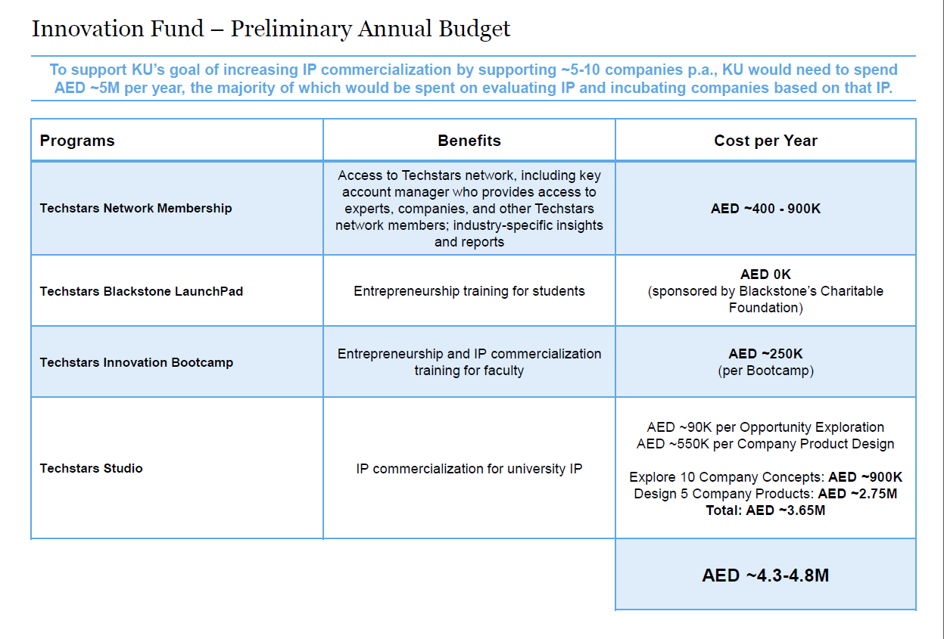
Thank You

Slide 17
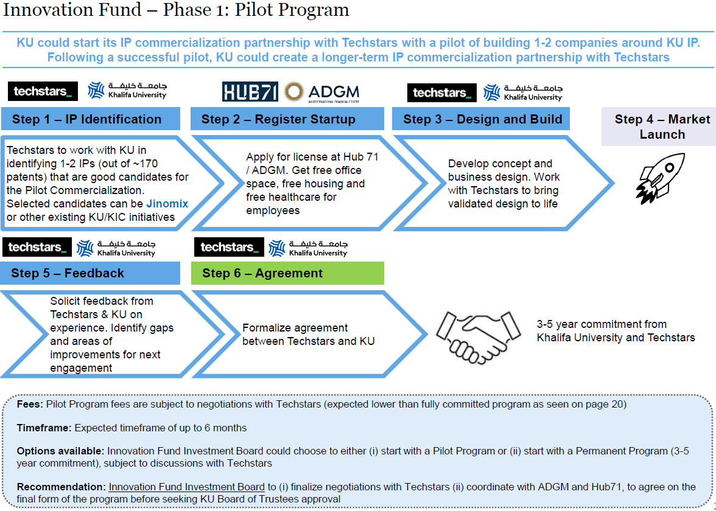

Slide 18




Proposed Companies
Ankabut
Business aligned technology with proven capabilities in the Learning Management System, Application Development / Maintenance, Cloud Computing, and Data Centers. Abkabut Leading in operating education Network (NREN) in UAE.
Jinomix
Jinomix is a comprehensive DNA and genome screening company that offers services to populations of the UAE and those that live in the surrounding region.
KU Enterprises CompanyL.L.C
Khalifa Innovation Center
Khalifa Innovation Center is an innovation-based incubation center supporting high tech/high-impact start-ups to bring their new and improved products to the market.
Wastewater
This is a research project using state-of-the-art university testing facility to serve the UAE in its fight against COVID 19. It uses the highest standards in water and wastewater testing and analysis.

Slide 19


Proposed Companies
Local Manufacturing of Extraction Reagents
This is a scientific project led by university in support of the fight against COVID 19. It focuses in manufacturing reagents needed for the extraction of RNA from coronaviruses, currently in high demand due to the current global pandemic
Advisory Services
Provide advisory and consultancy services to the community, using high profile university faculties and staff experience in different scientific and technical areas of need and impact to UAE services .
KU Enterprises CompanyL.L.C
Sports Equipment Manufacturing Company
Manufacturing facility to cater to the domestic needs of light-weight sporting equipment stemming from cutting edge R&D. It is first of its kind in the GCC region, and the current focus is on manufacturing bicycle frameset using composite materials

